Slide 1


ONLINE MUSICAL SYSTEM

Slide 2




INTRODUCTION
Welcome to our revolutionary online music system application, your ultimate destination for a music journey like no other. Our application is a musical haven, designed to elevate your listening experience. Explore an extensive library of songs, discover new tracks, and create customized playlists to suit your every mood. Immerse yourself in the world of music, where your personal preferences matter. With an intuitive user interface and seamless navigation, finding and enjoying your favorite songs is a breeze. Whether you're looking for chart-toppers, hidden gems, or a sense of community among music enthusiasts, our application is your one-stop solution for all things musical.
Get ready to embark on a harmonious adventure with us!

Slide 3

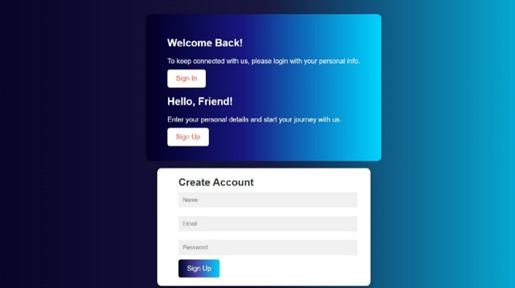
SECURE AUTHENTICATION
. SIGN- IN/ SIGN- UP
The authentication page serves as the entry point for users. They can either sign in if they have an existing account or sign up to create a new one.
. SECURE CREDENTIALS
Users are required to provide their credentials, typically an
email or username and password, ensuring secure access to their accounts.
. PASSWORD RECOVERY
Include a "Forgot Password" option for users to reset their
password in case they forget it.
. SECURITY MEASURES:
Implement robust security measures to protect user data,
including encryption and secure storage of user credentials.

Slide 4

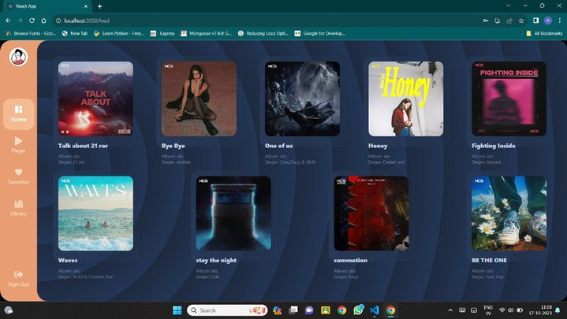

SIMPLE DASHBOARD DESIGN
. SONG DETAILS:
Each song is displayed with details such as title, artist, album,
release date, and genre.
. PLAYBACK OPTIONS:
Users can start playing a song directly from this page with a
click, making it convenient to enjoy music.
. ACCESSIBILITY:
Make the song page accessible to users with disabilities,
following web accessibility guidelines.
. SCALABILITY:
Design the page to handle a growing library of songs,
ensuring it remains user-friendly as the collection expands.

Slide 5


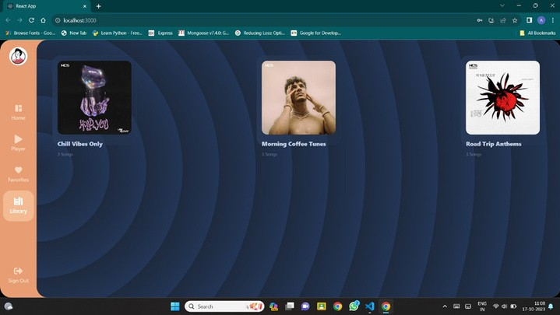
PLAYLIST
. PLAYLIST LIBRARY:
The playlist page serves as a hub for users' playlists, both personal and curated.
. CREATE NEW PLAYLISTS
Users can create new playlists, giving them the freedom to organize and categorize songs as they like.
. ADD AND REMOVE SONGS
Users can add songs to playlists or remove songs from them, offering flexibility in playlist customization.
. PRIVACY SETTINGS:
Allow users to set privacy options for their playlists, such as public, private, or shared with select users.
. REORDERING TRACKS:
Allow users to change the order of songs within playlists, providing full control over the playlist's flow.
. EXPLORE CURATED PLAYLISTS:
Offer a selection of pre-made playlists for users to discover new music and genres.

Slide 6

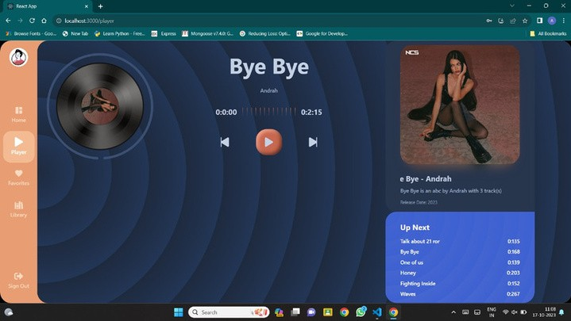

SONG PLAYBACK
. SONG PLAYBACK
The page allows users to play and pause songs, offering control over their music
listening experience.
. SONG DETAILS
Display comprehensive information about the song, including the title, singer, composer, album, and release date.
. PREVIOUS AND NEXT BUTTONS
Include buttons for users to navigate to the previous or next song in the playlist.
. ADD OR REMOVE
Users can access and manage their playlists from this page, making it convenient to add or remove songs.
. REORDERING TRACKS
Allow users to change the order of songs within playlists, providing full control over the playlist's flow.
. OFFLINE LISTENING
For premium users, provide the option to download songs for offline listening.

Slide 7


TECHNOLOGY STACK
FRONT END
HTML CSS React.Js
BACKEND
Express.Js MySQL

Slide 8



CONCLUSION
In conclusion, our online music system application represents a gateway to a world of melody, creativity, and community. With a user-friendly interface and a wealth of features, our platform provides an immersive and personalized music experience. From the Home Page, where users can discover new favorites, to the Playlist Page, offering complete customization, and the Song Playback Page, where users can enjoy music at their fingertips, our application is designed to cater to every aspect of your musical journey. We're committed to continuous improvement, with future enhancements in mind, and we're excited to be your companion in exploring the harmonious world of music. Thank you for joining us on this incredible journey.

Slide 9


FINAL WORDS
Music is the movement of sound to reach the soul for the education of its virtue.
PLATO
AAI | Pro X

